Slide 1
The Importance of Execution Time
Notes:
As you learn more about algorithms, you’ll need to start thinking about the resources that they require. Actually, there are two main resources that an algorithm requires...

Slide 2


Limited Resources for an Algorithm
Storage Space
Time
Notes:
Two limited resources: time and storage capacity
Trade-off between the two
e.g., a faster algorithm uses more memory
Given today’s technology, you usually don’t have to worry about storage space.
Memory is plentiful and cheap.
On the other hand, time can be a major concern.
Working in data science, datasets tend to get bigger and bigger.
The problem is that with more data, the time it takes to finish can get so big that it’s impractical. It might be that your algorithm can take 100s of years to finish.
Actually, a lot of cryptography works based on this principle.
Famously, if you had a fast algorithm that can factor a product of two

Slide 3
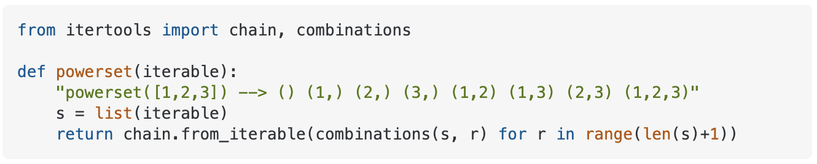
Subset Example
Given a set S, a subset of S is a set that includes elements of S but no other elements.
Example: S = {Diego, Sruthi}
The subsets of S are: {}, {Diego}, {Sruthi}, {Diego, Sruthi}
Python function to create set of all subsets:
Notes:
Why would you need to check every subset?
Maybe you want to find an optimal team. Maybe you need to score groups of people to estimate if they could be in a terrorist network.
Maybe instead of people you have letters, and you’re playing a word game where you need to use some of your pieces.
In my own research on privacy, I sometimes come across a need to do this.
So, it’s not a crazy idea.

Slide 4
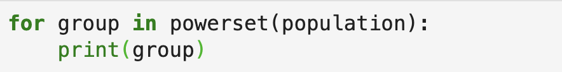
Subset Example (cont.)
How long will it take to print every subset?
Number of people | Number of prints
1
2
10
100
1,000
Notes:
Fill in the answers:
2
4
1024
a big number - 31 digits long!

Slide 5
Subset Example (cont.)
How long will it take to print every subset?
Number of people | Number of prints
1 | 2
2
10
100
1,000
Notes:
Fill in the answers:
2
4
1024
a big number - 31 digits long!

Slide 6
Subset Example (cont.)
How long will it take to print every subset?
Number of people | Number of prints
1 | 2
2 | 4
10
100
Notes:
Fill in the answers:
2
4
1024
a big number - 31 digits long!

Slide 7
Subset Example (cont.)
How long will it take to print every subset?
Number of people | Number of prints
1 | 2
2 | 4
10 | 1,024
100
1,000
Notes:
Fill in the answers:
2
4
1024
a big number - 31 digits long!

Slide 8
Subset Example (cont.)
How long will it take to print every subset?
Number of people | Number of prints
1 | 2
2 | 4
10 | 1,024
100 | 1,267,650,600,228,229,401,496,703,205,376
1,000
Notes:
Fill in the answers:
2
4
1024
a big number - 31 digits long!

Slide 9
Subset Example (cont.)
How long will it take to print every subset?
Number of people | Number of prints
1 | 2
2 | 4
10 | 1,024
100 | 1,267,650,600,228,229,401,496,703,205,376
1,000 | 1.1 × 10³⁰¹
Notes:
Fill in the answers:
2
4
1024
a big number - 31 digits long!
a number with 301 digits - that’s many times the number of atoms in the known universe.
I don’t care how fast your computer is. you won’t be able to run this code if you have hundreds of years.

Slide 10
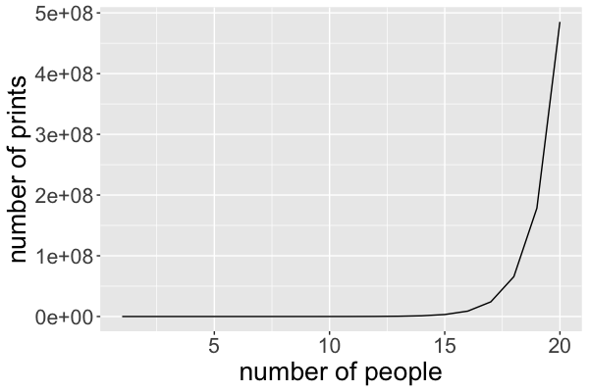
Growth Rate of Subset Algorithm
Notes:
This plot shows what we call the growth rate of the execution time.
On the x-axis is the number of people
on the y-axis is the number of prints.
This is an example of what we call an exponential algorithm.
This curve grows exponentially quickly - and that’s really fast.
An algorithm like this is impractical, unless the size of your dataset is tiny: 10 people is ok, but not much more.

Slide 11
Cryptography Example
Problem: Given a number X with n digits, find all factors of X
Example: X = 15; 15 = 3 × 5
Belongs to the class of problems called NP
Fastest known solutions take exponential time
Notes:
Just for fun, I want to mention one area where exponential runtimes are actually a good thing.
Here’s a famous problem from cryptography.
Given a big number X, find the factors of X.
If you could always solve this problem quickly, you could break a lot of encryption algorithms.
If you’ve ever heard the term NP - that’s a class of problems studied by computer scientists.
Until today, the only algorithms we have for this class take exponential time.
Encryption works, because it would take hundreds of years for someone to factor a big number.
Of course that’s good for security, but bad if you want to analyze a dataset.
So today we’re going to spend a lot of time discussing tools for thinking about the runtime of algorithms.

Slide 12
The Importance of Execution Time

